Slide 1
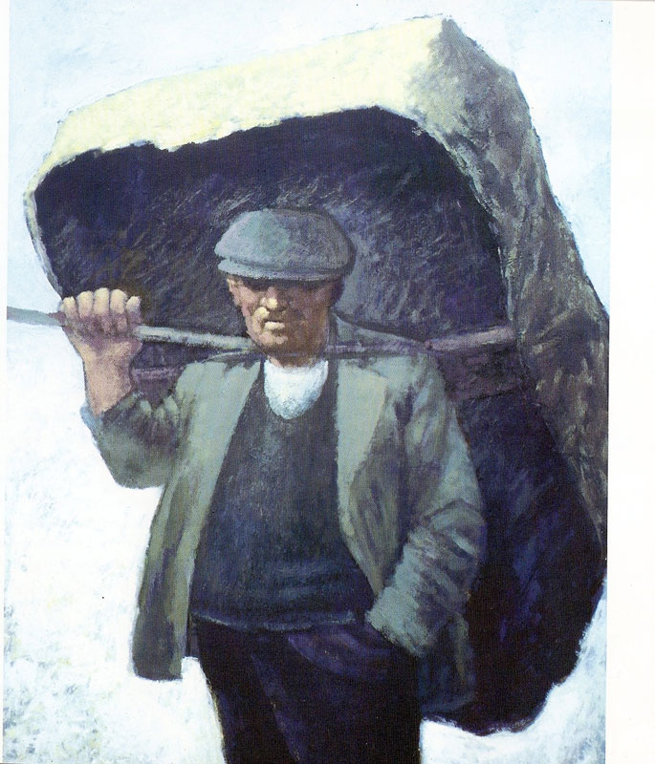
Used with kind permission of Aneurin Jones
A series of interactive lessons and instructions for teachers to create a art project:
Years 5 a 6
Lesson 12
Workers and the workhouse during Victorian Times
Next page
Notes:
1

Slide 2
Evaluating you work
Discuss your work in a sensible and positive way. Include what has influenced you and how you went about creating your product.
Click here for sentences and
evaluating vocabulary
In your evaluation your teacher is looking for use of vocabulary, techniques used, the artist that you researched and the equipment used. Remember to express your opinion about your own work and work created by others in a positive way.
Previous page
Next page

Slide 3
Evaluating your work
Questions to help you:
What artists did you study and how did their work influence you?
What techniques did you use in order to complete you finished art work?
Where there any problems with the techniques used?
What equipment did you require?
What do you like about your finished piece?
What would you change if you had the option to do the project again?
How will you now show your art work?
Is there any other work in the class that you like? Why?
Previous page
Next page

Slide 4
Sentences and Evaluating Vocabulary
My main influence as I created my work was...
I was inspired by...
The subject or theme of my work was...
The techniques that I used were...
I decided to use these because...
The equipment that I required was....
My favourite part of my work is...
One thing that I would like to change is...
In my opinion the project was...
The most enjoyable part was ...
The part that I least enjoyed was….
A new skill that I learnt was ...
artist/artists
investigate
topic
mood
colour and tone
techniques
mediums
copy the style
Convey emotion
equipment
Success
New skills
In my opinion
Previous page

